Slide 1
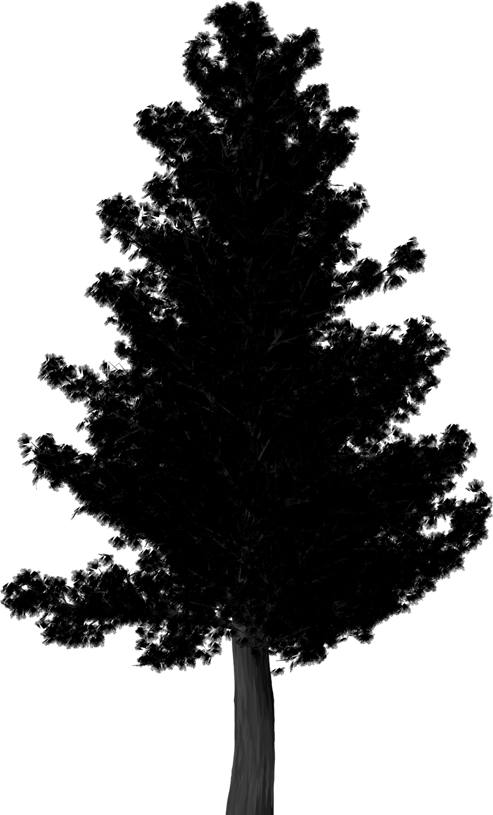
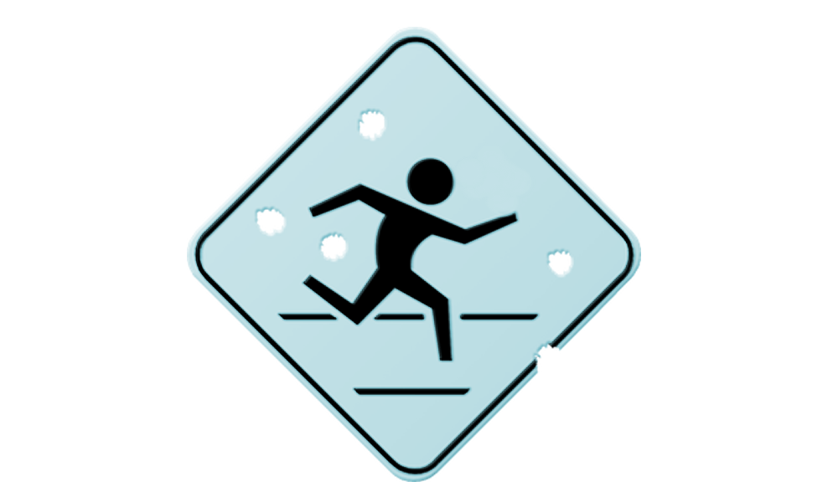

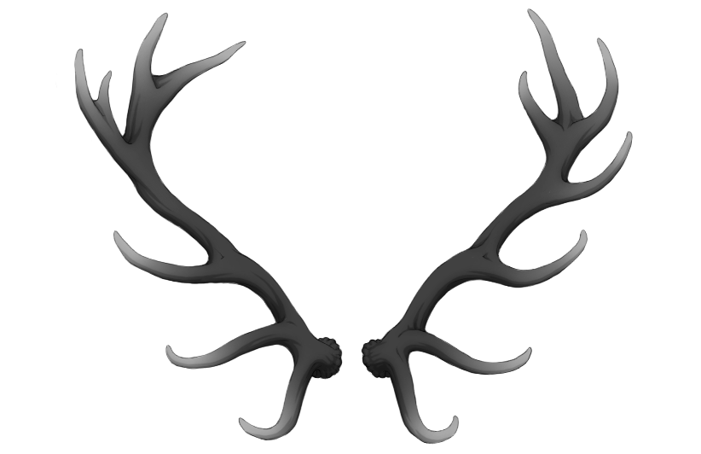
Run for your life
Roger Martin-pero Otin 195003
Ferran Enguix Trancoso 195659
Lluis Hernández Melià 193200
Daniel Mateos Manjón 205514

Slide 2
Summary
TOPIC
MAIN IDEA & INTERACTION
STORYBOARD OF THE INTERACTION
AVATAR
SCENERY
MAPPINGS
FEATURES
PERSONAL COMMENTS

Slide 3
1. Topic
Entertainment and exercise.
All around family-friendly game.

Slide 4
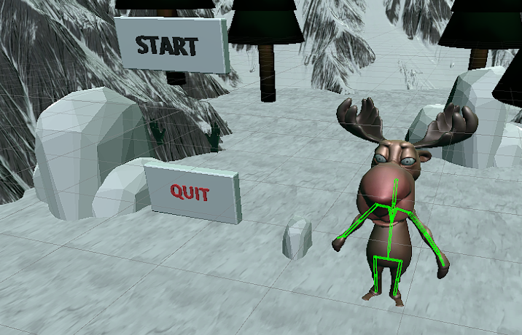
2. Main idea & Interaction

Slide 5
2. Main idea & Interaction
Main Idea:
Endless running game where the player has to avoid obstacles.
Ambiented in an ice oriented scenery.
Emphasis on possible exercising applications.
Interaction:
Representation of the player
It gets information and changes the output in function of the input → Contributive interaction.
Each movement registered affects the output of the application.

Slide 6
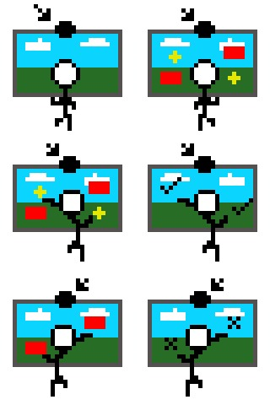
3. Storyboard

Slide 7
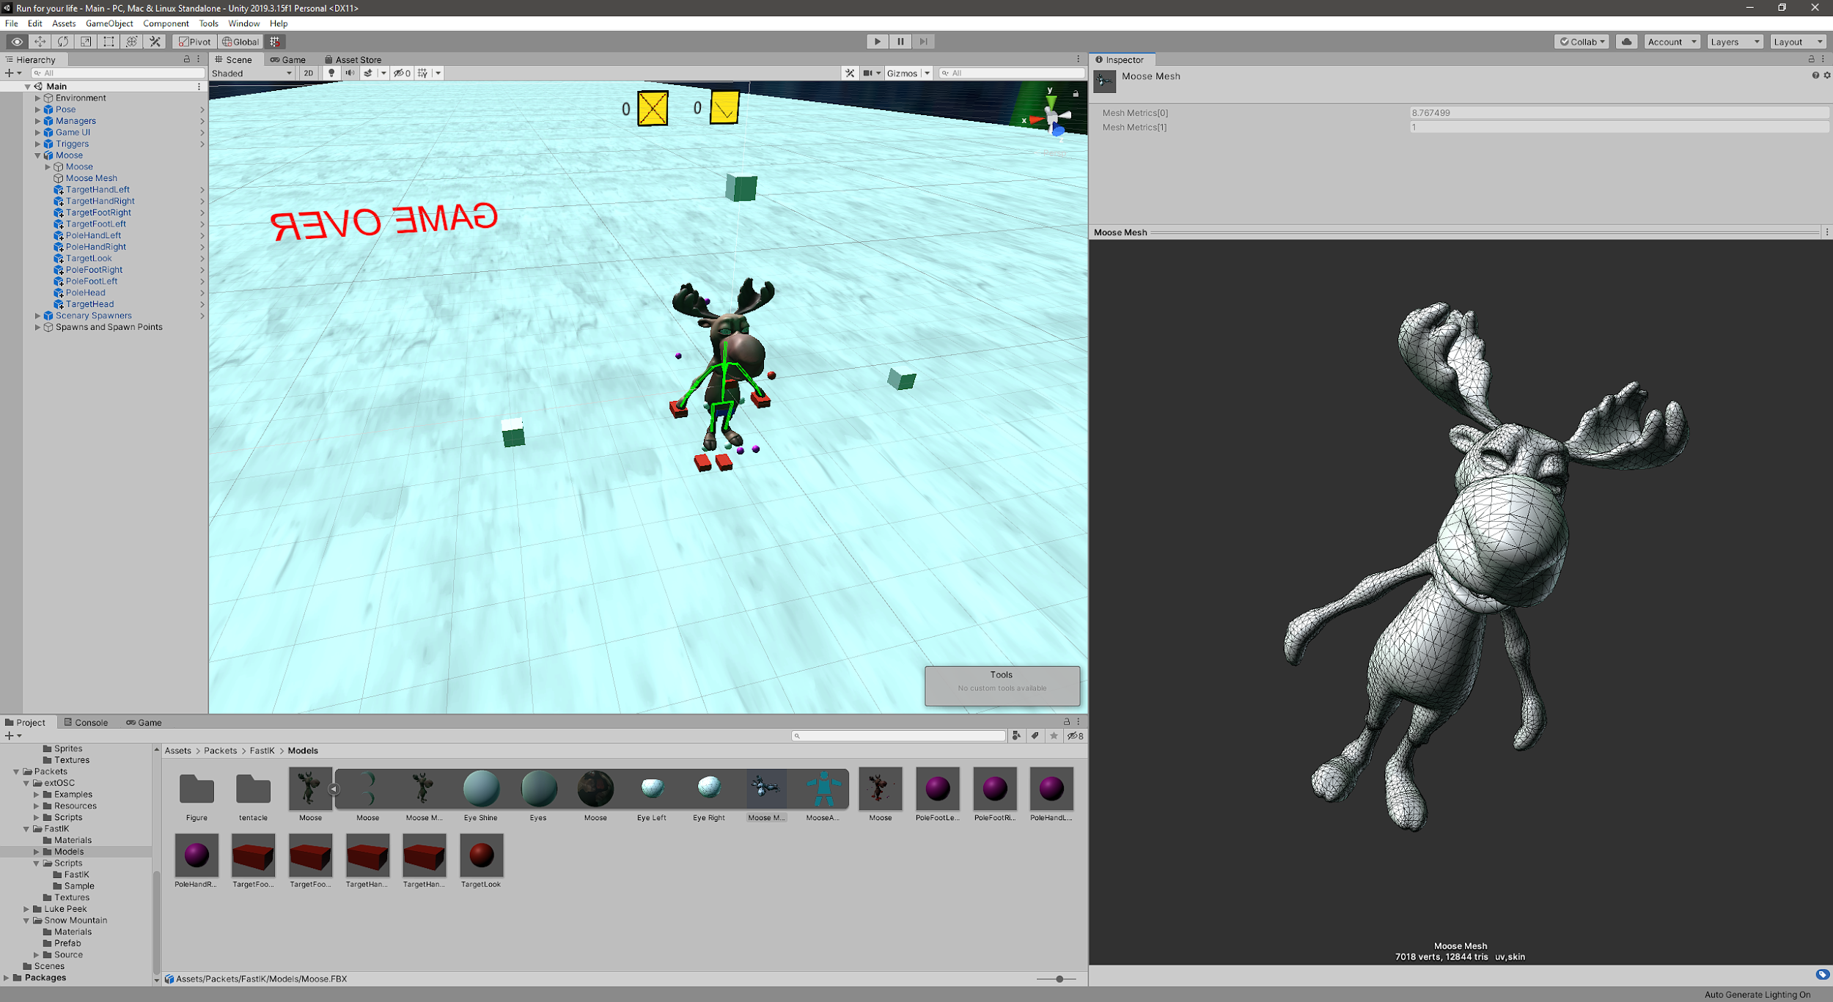
4. Avatar

Slide 8
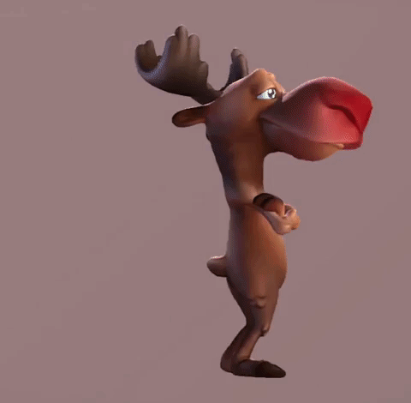
4. Avatar
→ Commercial model available at Sketchfab:
https://sketchfab.com/3d-models/moose-1087d02ab0024c458091acae86cf6916
→ 7K verts, 12K triangles, low poly.
→ Fully Rigged.
→ Full-body Inverse Kinematics integration from FastIk library.
(Some features deactivated for the demo)
→ “Custom” running animations so it can work alongside PoseNet.

Slide 9
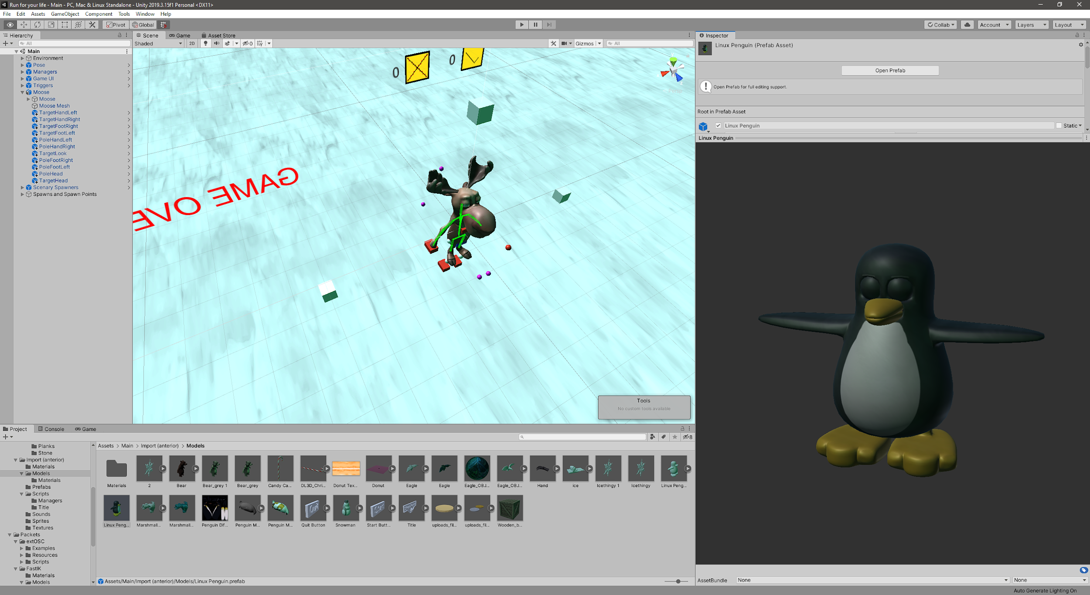
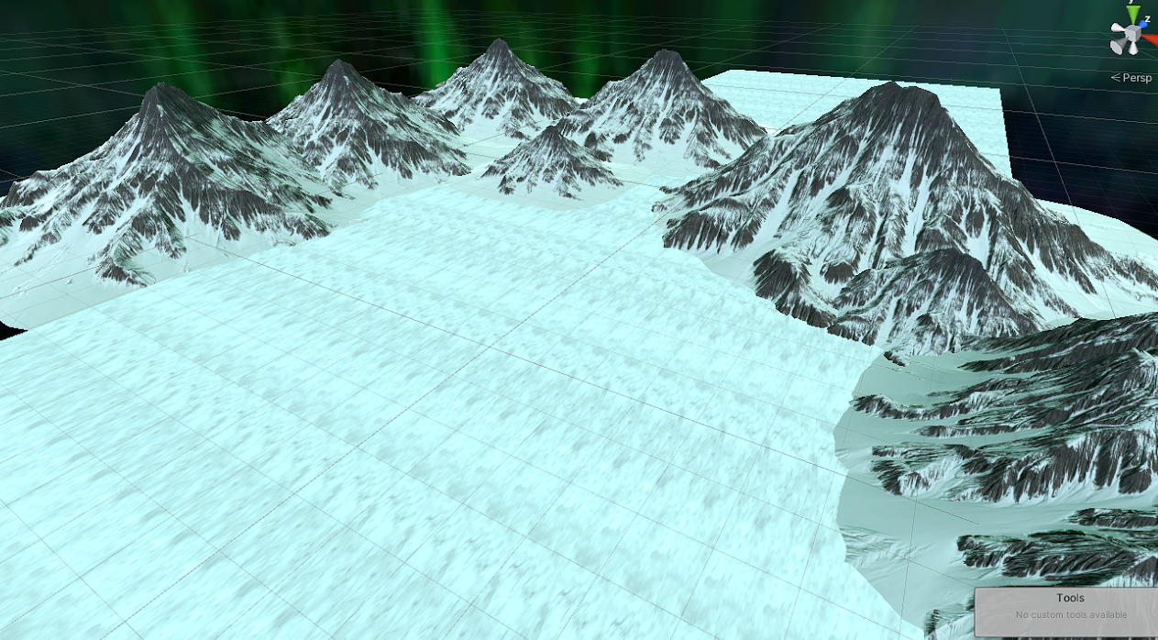
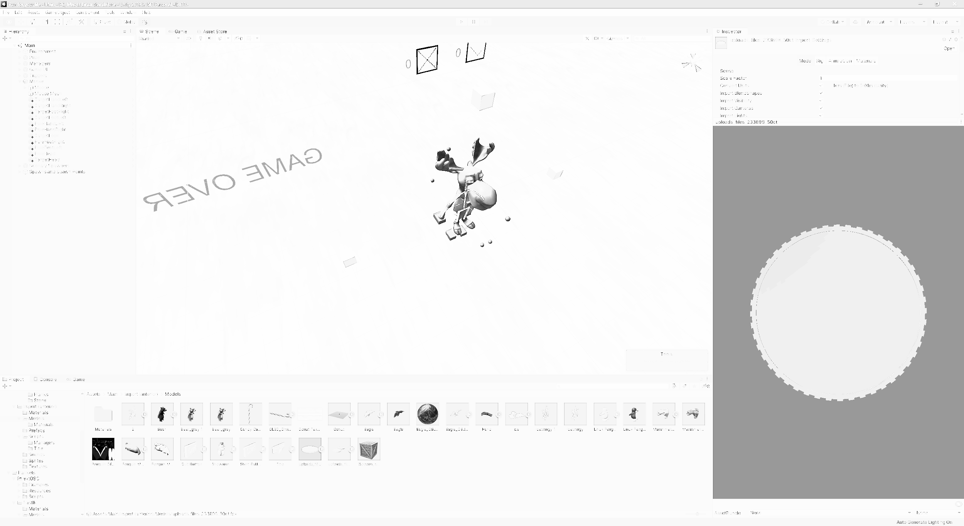
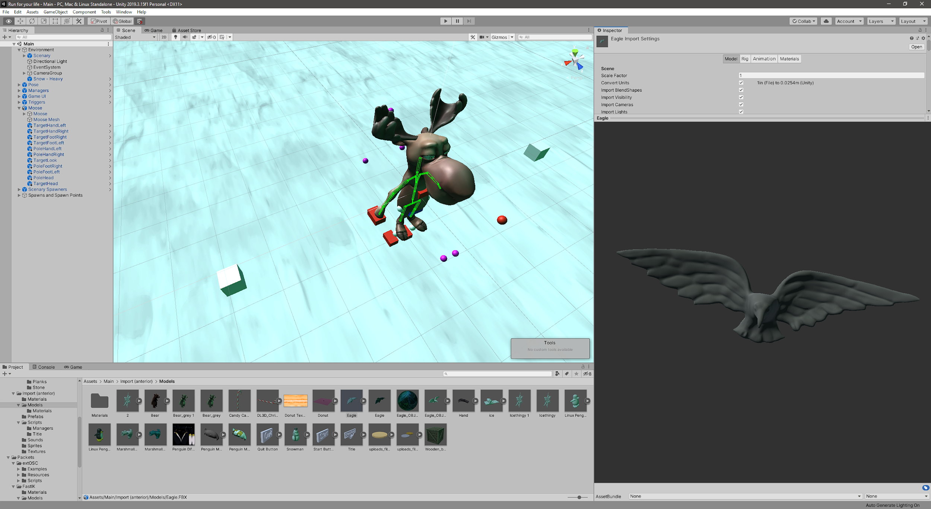
5. Scenery
Ambientation
-Ice and tundra situation.
-Characters based on wildlife.
Point encouragement
-Coins used as collectibles.
-Eye-Catching.
-Attempts to introduce the idea the of being collected.
Penalization objects
Dual idea:
-“Adorable” creatures used to avoid crashing into them.
-Intimidating animals that the players also should get away from.

Slide 10
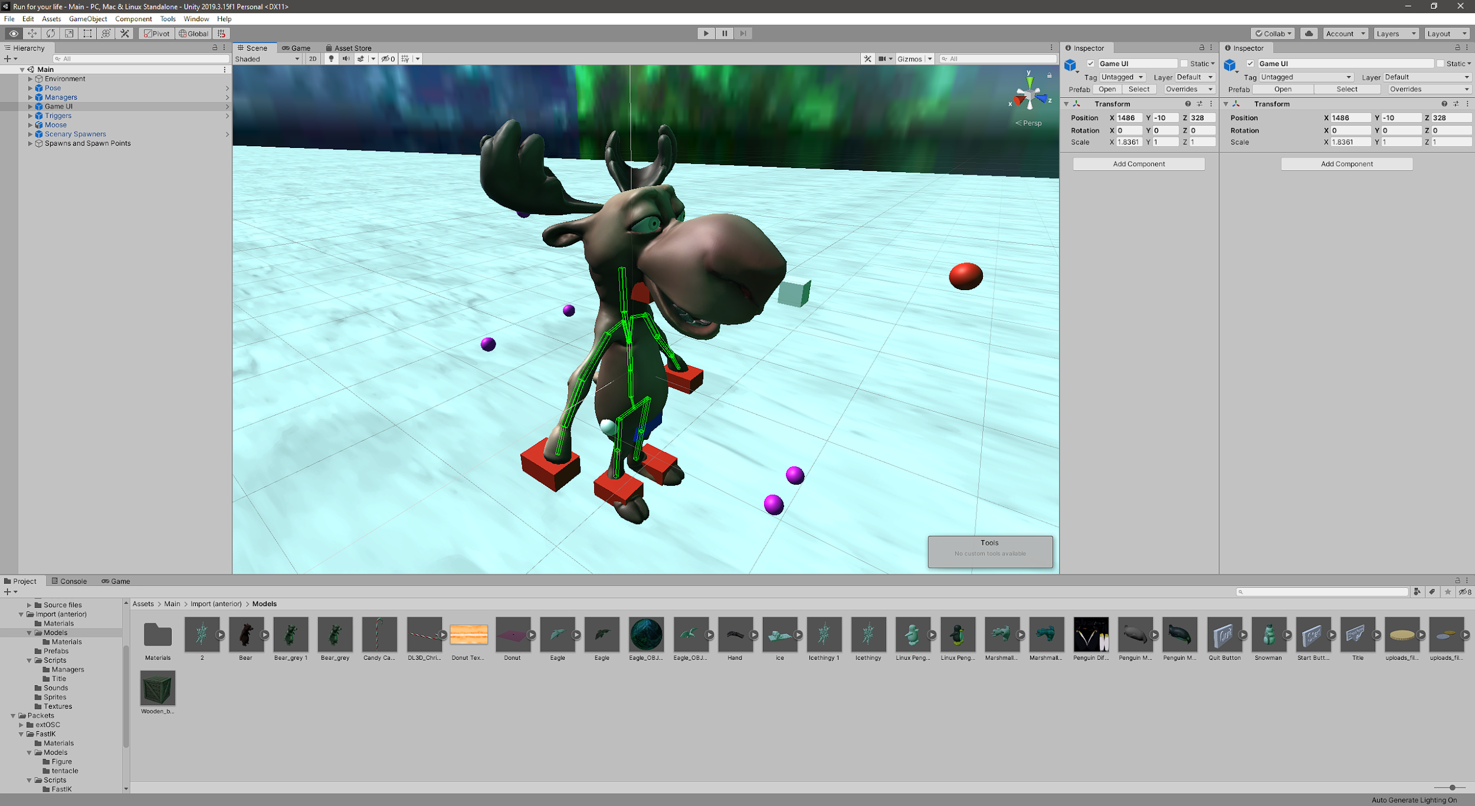
6. Mappings
Place your screenshot here
One-to-One Mappings for:
-> Wrists L/R
->Elbows
-> Head/neck
On a 1:1 Scale from PoseNet to GameWorld
No smothering applied

Slide 11
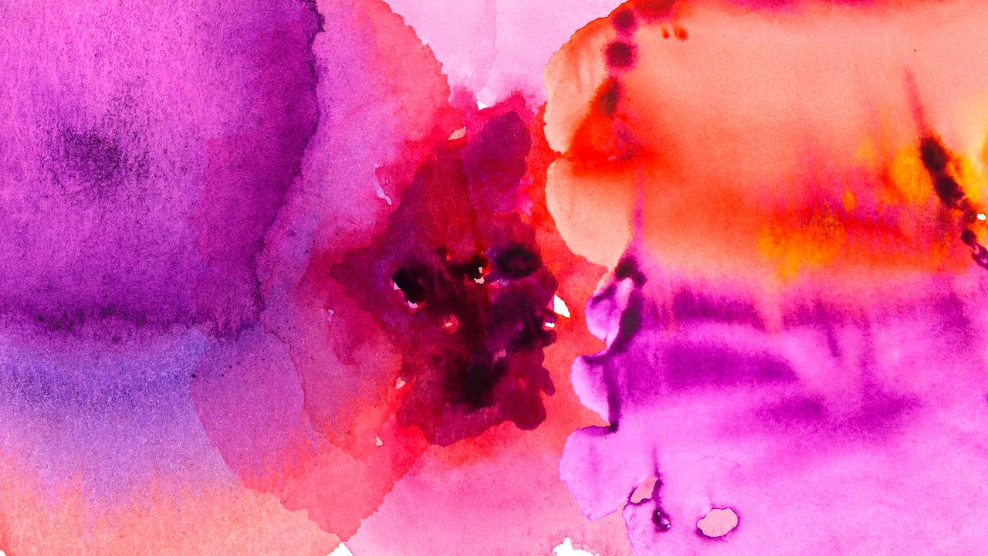
7. Features
Comfortable and easy UI.
Fade In Fade Out of scenes.
Music ambient.
Count of obstacles avoided, collided and total points.
Graphic elements.
Using a 3D model of a moose.
Snow falling.
Ambiented in a mountain range with northern lights.
Playability.
Sound effects to have feedback.
Tested to adjust parameters and colliders.
Optimized algorithm for object spawning.

Slide 12
8. Personal comments
Future Work:
Speed change over time
Add lifes.
Implement different difficulties.
Testing of the prototype
We have tested the prototype of the game with family and friends to collect their feedback to improve the game. Some opinions:
Too slow to be challenging.
The motion capture is “Buggy”.
Your avatar’s face is creepy.

Slide 13

DEMO

Slide 14
Run for your life
THANKS!!
Roger Martin-pero Otin 195003
Ferran Enguix Trancoso 195659
Lluis Hernández Melià 193200
Daniel Mateos Manjón 205514

